Slide 1
ToDo App
By
Chitra Joshi

Slide 2
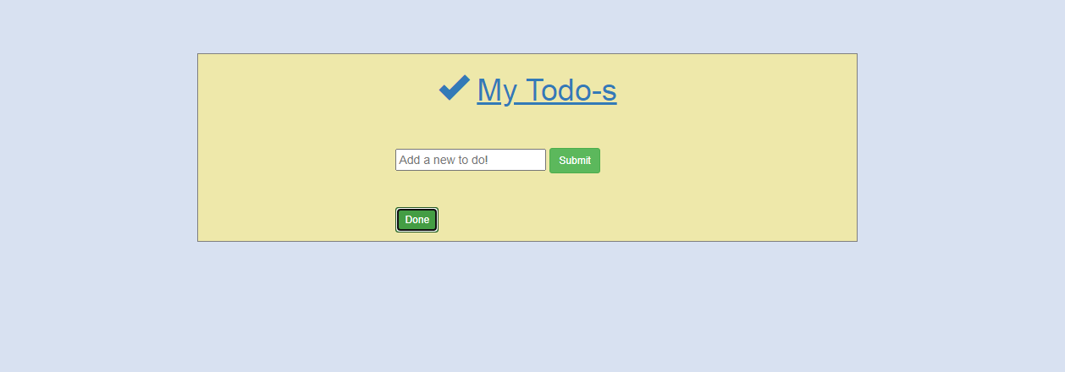
First View of App

Slide 3
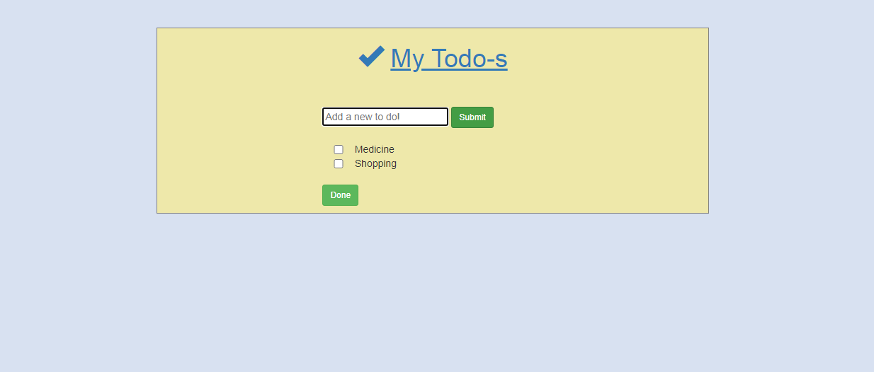
After Submitting ToDo’s

Slide 4
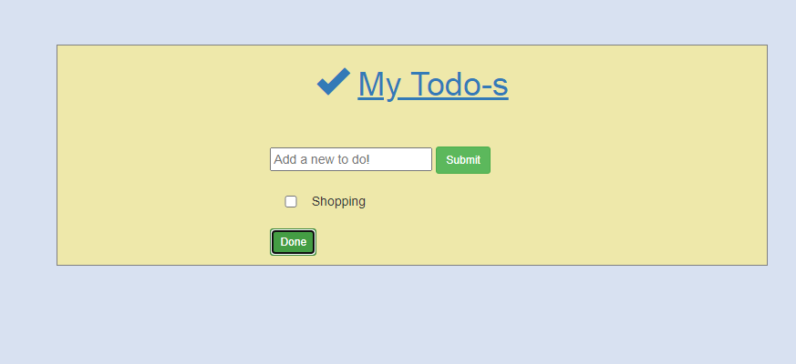
After Done of the ToDo’s

Slide 5
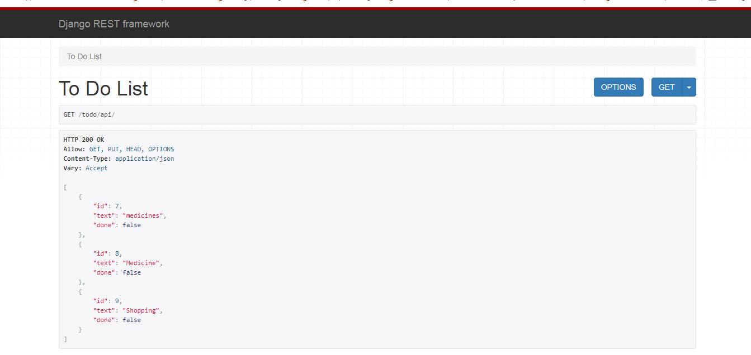
API View

Slide 6
Thank you…!

